Slide 1
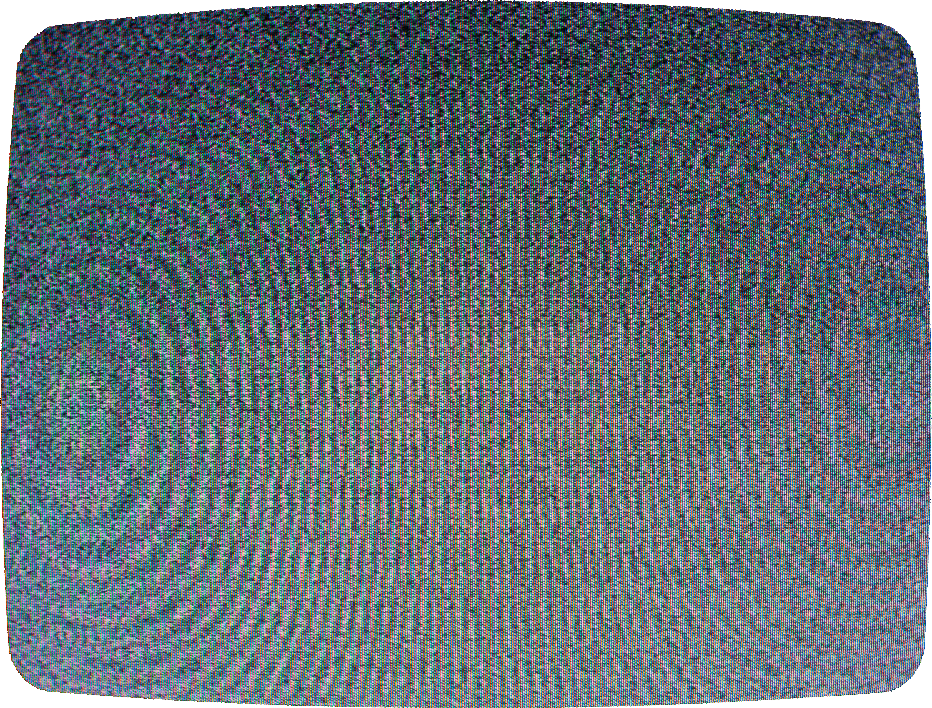
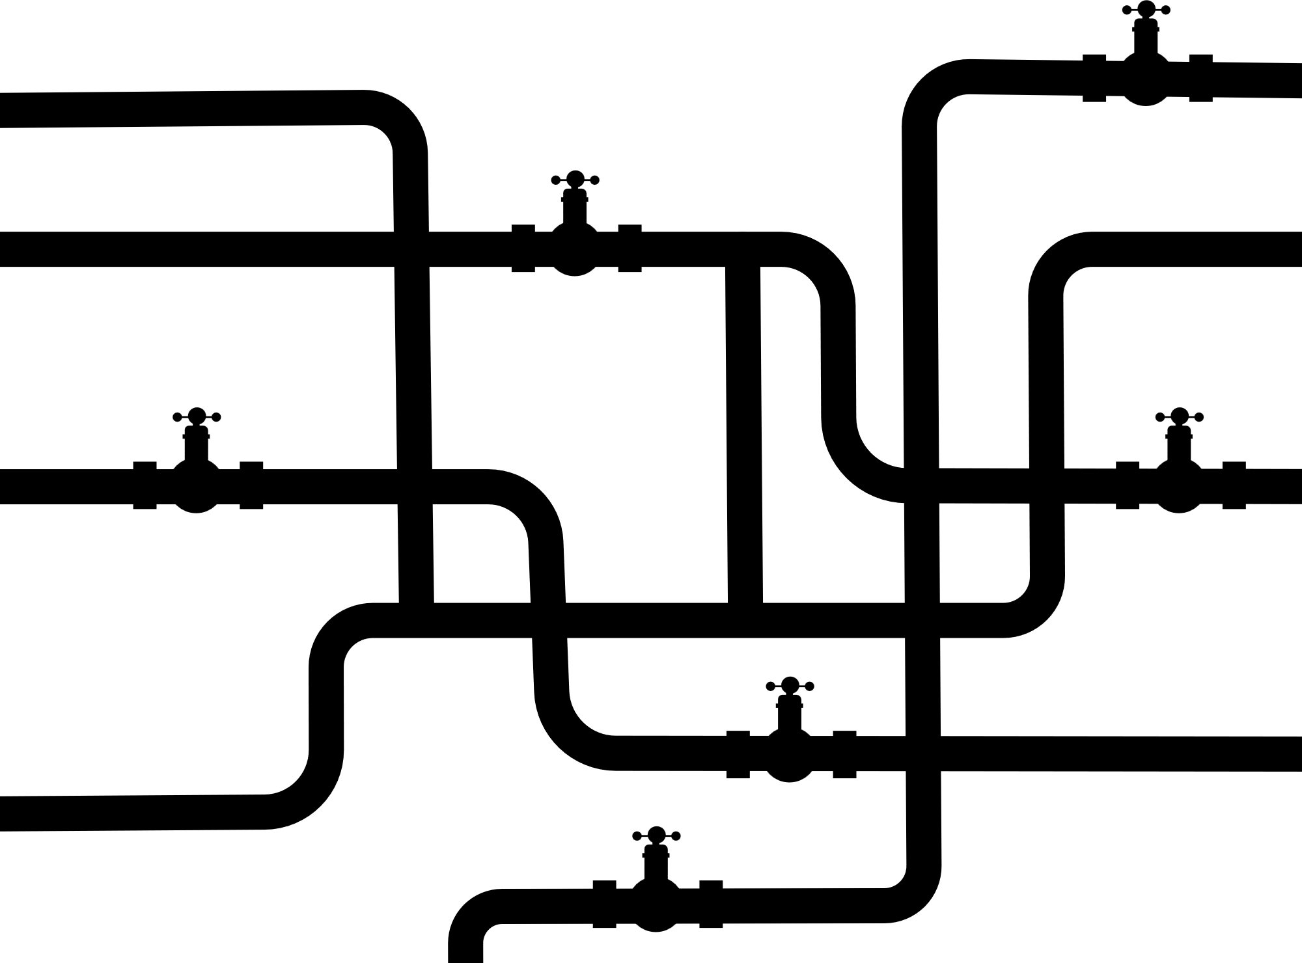




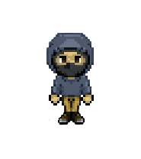
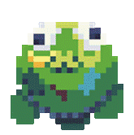
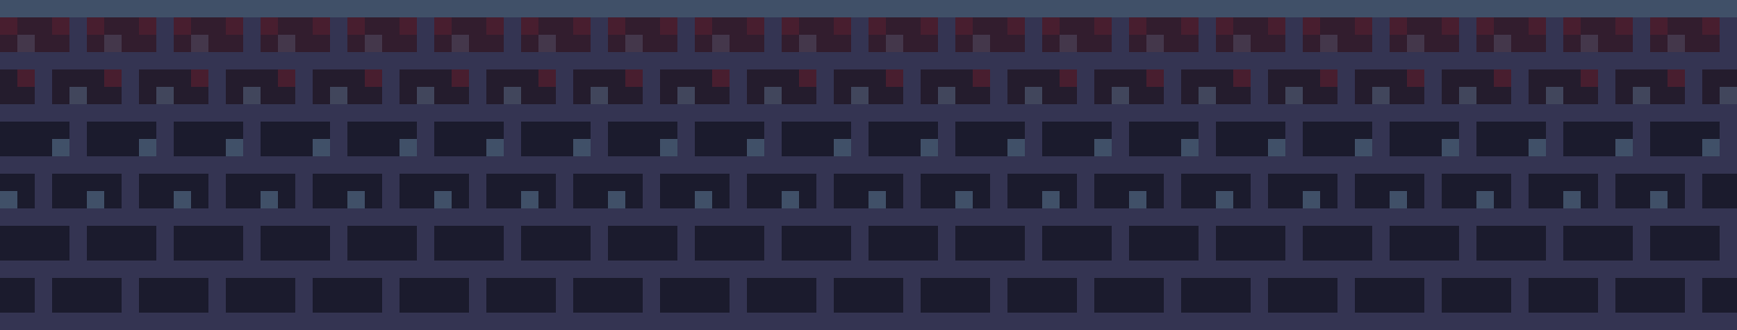
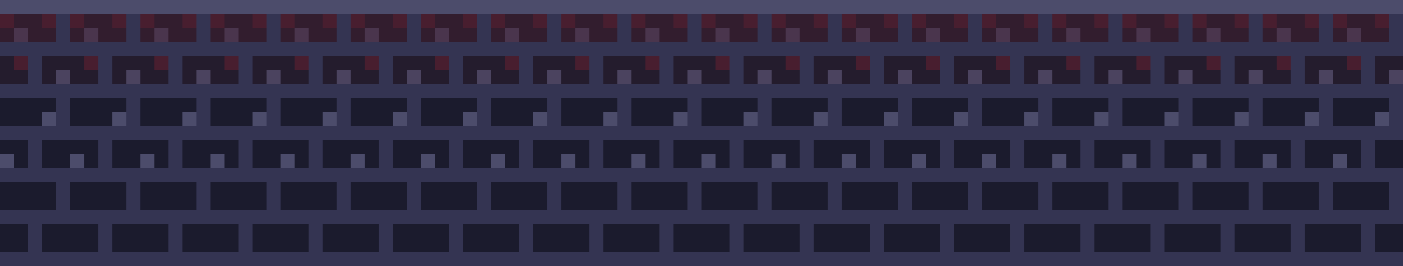
Social Marketing Proposal
Notes:
In Presentation mode, the graphics display appropriately. Since Sluggerpunk is a game based in the underground in a futuristic, dystopian setting, I used CRT static to add an ominous effect on top of a brick background with colors that fit the game.

Slide 2


Introduction
This campaign proposal is dedicated to best contribute to the successful launch of the new indie title “Sluggerpunk “ which is set to release on December 5th, 2024.
While looking to drive awareness and convert gamers to paying customers, we’re looking to involve creators and influencers to have good will within the indie game communities they are a part of so that we may best connect with niche audiences. Through the collaboration with these creators, we will also host digital events and giveaways to best make sure this roguelike title will be a memorable one.

Slide 3
Game Brief
Set in a totalitarian future where competitive sports have been banned except for underground illegal battle sports. These rebels known as sluggerpunks fight back against oppressive governments.
Sluggerpunk is a futuristic/cyberpunk action rpg where players use sports-related items, primarily a baseball bat, to engage in bullet hell combat.

Slide 4
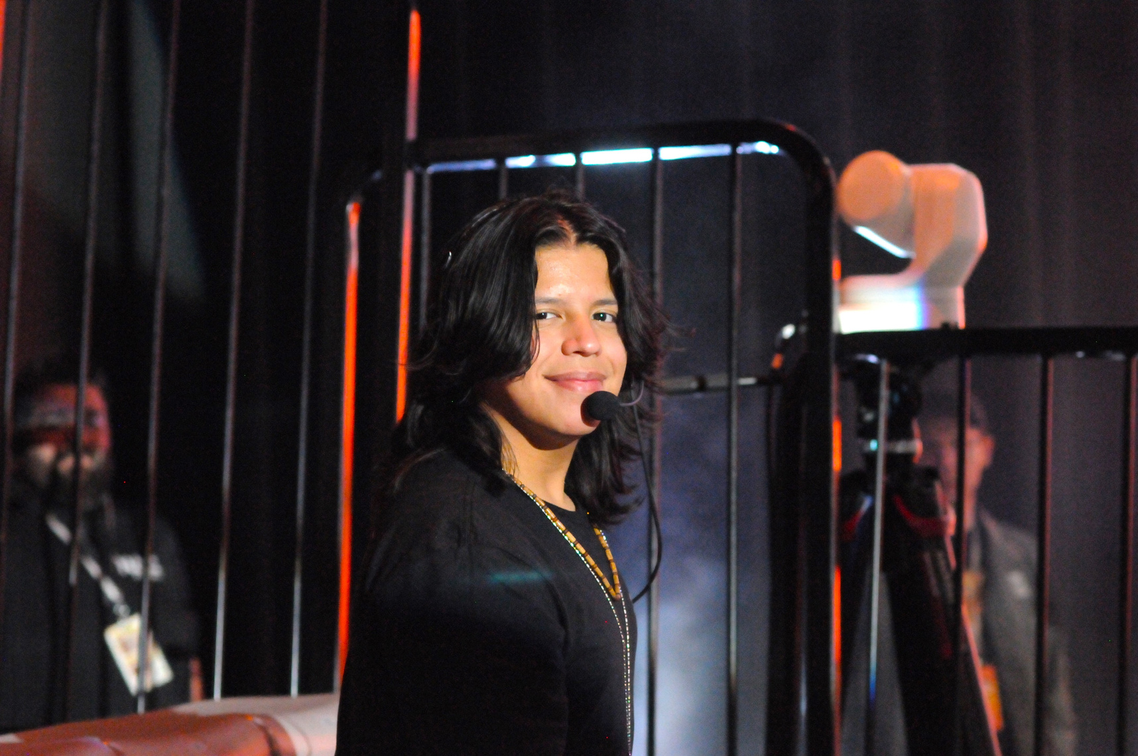

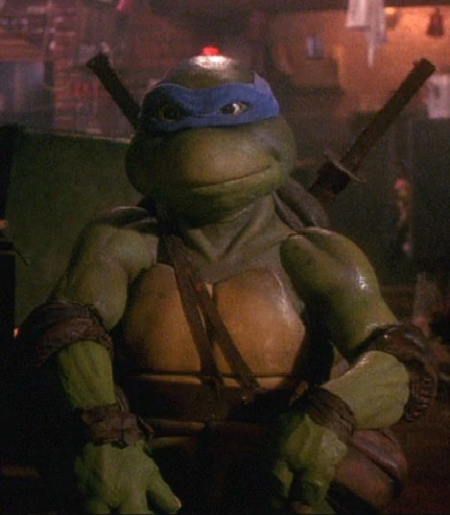

The Marketing Team
Campaign manager
Digital marketing manager
Social marketing manager
John Fernando
Leonardo
Don Cheadle
  created the communication strategy for halo infinite
  38+ yrs marketing experience
  ran several marketing campaigns for the “marvel rivals” ip
  Specialty in working on retro games
  generated 12.1 mil. leads last quarter
  Two screen actors guild awards

Slide 5


Marketing Methods
Digital, Paid Advertisements
Facebook
TikTok
In addition to:
  Organic Content on Sluggerpunk Socials
  Strategic Influencers and
  a whole ton of Giveaway Contests
  Events !
Instagram
YouTube
Twitter
retargeting and A/B testing
With the help of UGC Ads
sourced by creators on Fiverr
Notes:
All relevant marketing methods are highlighted in pink text, drawing attention to those marketing methods.
Pay particular attention to setting up retargeting and a/b testing which will be essential to dramatically reducing the cost per acquisition of each new player.

Slide 6
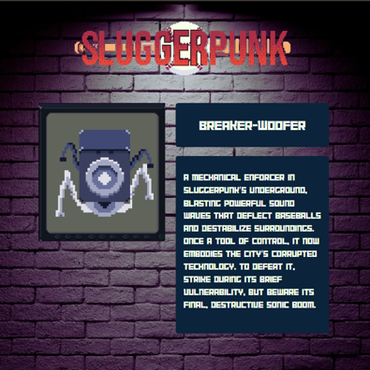
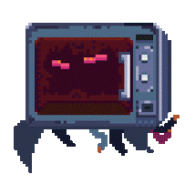
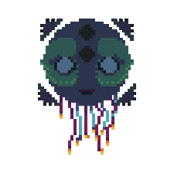
Organic Content
BUILDS
Unique builds with in-game items that allow for different levels of difficulty or power levels can be an interest in players wanting a challenge.
BUILDS & SCORES
ACHIEVEMENTS
Talking about milestone levels, bosses, or unlocks in the game. The game features a total of 24 Steam Achievements for achievement hunters and completionists to acquire.
DEVELOPMENT LOGS
Developer updates as to design decisions, community polls, or upcoming features can involve players in the game’s development and have players return for new mechanics
DEVELOPMENT
ART & DESIGN
sharing the concept art for NPCs, mobs, levels and assets used for the visual creation of the game
Notes:
Organic content strategy that best describes our social media approach to creating relevant content for the community.
Builds & Scores as well as development update to maintain transparency with the community.
The highlight of different character builds, & achievements are geared towards the “completionist gamer” side of the community
Development logs & the posting of art & design for upcoming characters to get a sneak peak into new levels being created, mobs being added to the game, or new items.

Slide 7
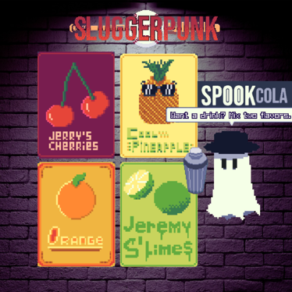
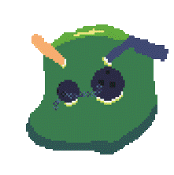
Organic Content
GAME STRATEGY
Highlighting game loadouts and item synergies for efficient and powerful gameplay to survive the toughest levels.
TACTICS & TIPS
BESTIARY
Pull information from the already existing in-game bestiary to inform players about enemy abilities and lore
STORY
Telling more stories about the Sluggerpunk world that aren’t in the game can engage with players that have already finished the game.
LORE
CHARACTERS
Sharing the character origin stories and lore to further immerse the player in the Sluggerpunk world
Notes:
Tactics & Tips, and Lore.
Sharing game strategy for some of the more challenges levels of Sluggerpunk could prove to be of benefit to its playerbase given its challenging nature. Learning about the monsters in the game through the bestiary would also inform players about their abilities and further their understanding of game strategy
To immerse the player in the world of Sluggerpunk through the release of short comics, transmissions, short stories, and character profiles.

Slide 8
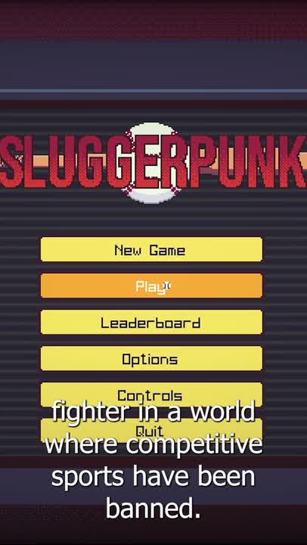
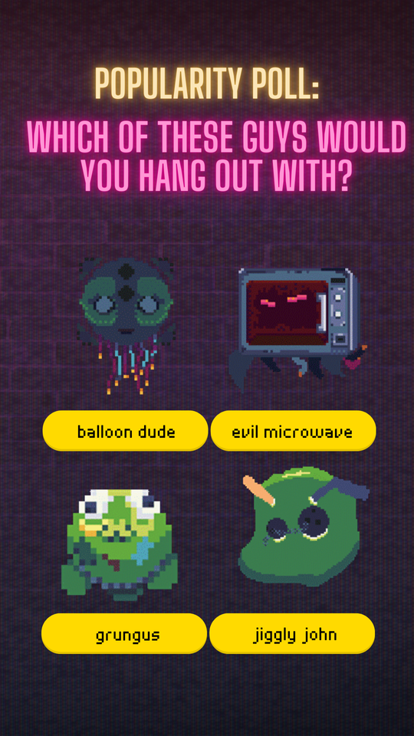
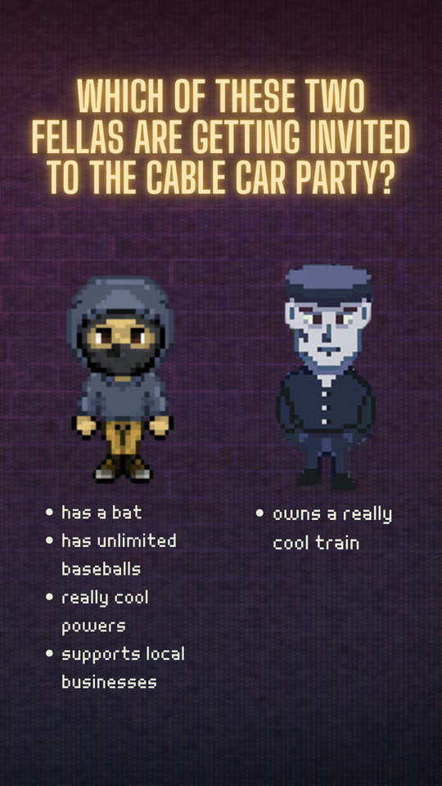
Organic Content - Social posts
Instagram stories
Sluggerpunk gameplay tiktok
Will you join the fight against against the government? Bring back sports and slug away in the underground of sluggerpunk!
Notes:
Examples of some of the social content that has already been prepared in anticipation of the release of Sluggerpunk
1 tiktok/short form video
2 Instagram/FB posts

Slide 9
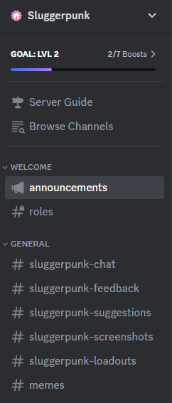

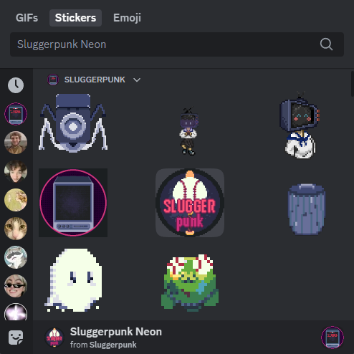
Sluggerpunk Discord Community
Patch announcements
Role request (With ambassador perks)
general chat
game feedback
share your own experiences
Sharing game loadouts
a silly time
Notes:
Sluggerpunk community discord which will be a big part of how we intend to communicate with our players and keep them engaged with our game.

Slide 10
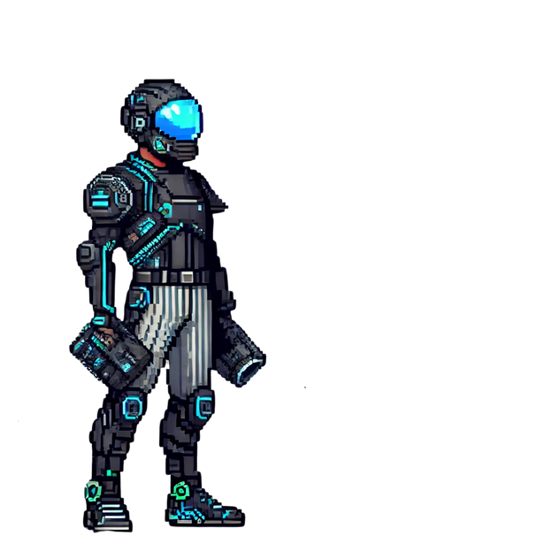
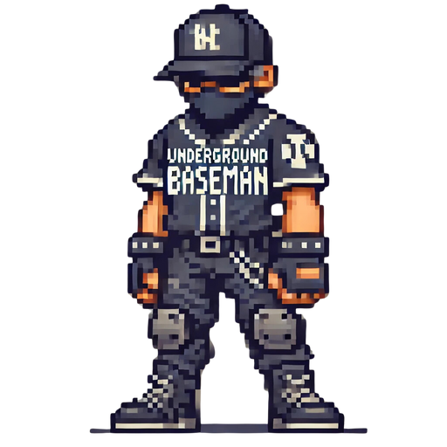
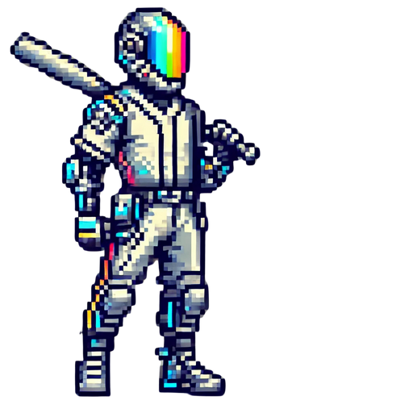
Sluggerpunk Ambassador Program
Tier 1 Underground Baseman
0-2 months, >3 downloads with Slugger code
  Free Sluggerpunk Pixel art wallpaper for mobile & PC
  Slugger code
  Game tester role in the Sluggerpunk Discord
Tier 2 Neo-Hitter
3-5 months, >10 downloads with Slugger code
  All previous rewards
  Followers get 1000 in-game currency upon use of creator code
  Ambassador Exclusive Cyberhitter character
  Monthly Q&A calls with developers
Tier 3 High Tech Pitcher
>6 months. >20 downloads with Slugger code
  All previous rewards
  Followers get 1500 in-game currency upon use of creator code
  Name in game credits as a game tester
  Sluggerpunk Baseball bat
Notes:
The ambassador program details with the in-game skins that will be given out to them.

Slide 11

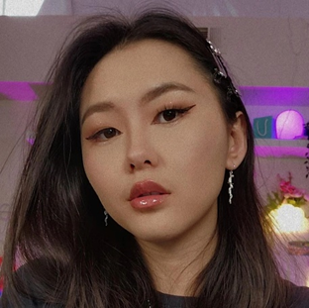
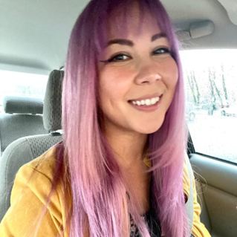

Strategic Influencer Sponsorships
Nookrium
172k Subscribers
Sondering Emily
80.8k Subscribers
Kimchica
63,5k Followers
Notes:
From left to right, TikTok, YouTube, & Instagram creators all having a niche within the indie game space.

Slide 12
Strategic Influencer Sponsorships
Kimchica
63,5k Followers
  short form content creator
  “Indiescovery” indie game coverage series for undiscovered gems
  Aesthetics and unique artstyle
  55/45 male to female audience
  Audience age between 14-21 years old
  14.26% engagement rate
Notes:
Kimchica is a creator that is transparent about what she likes and shares it with the world. She takes the games that she finds are under appreciated and sheds light onto them while also sharing her opinions and views on the game development world.

Slide 13
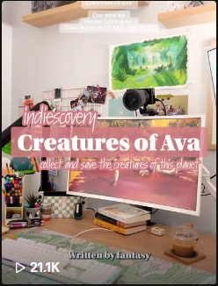
Strategic Influencer Sponsorships
Kimchica
63,5k Followers
Get kim to create a dedicated coverage piece for sluggerpunk as part of her “indiescovery” series on Tiktok that promotes up and coming indie games
Indiescovery episode for “Creatures of Ava”
21.1 k views on tiktok

Slide 14
Strategic Influencer Sponsorships
Nookrium
172k Subscribers
  Longform content creator
  Devoted to everything indie games with strategy
  Primarily male audience above the age of 16
  regular uploads 4 times a week
  1.43% engagement rate
Notes:
Nookrium’s audience is one that has stood the test of the time. His audience members are devoted and much easier to convert thanks to the goodwill he has built with his audience.

Slide 15
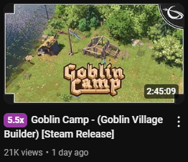
Strategic Influencer Sponsorships
Nookrium
172k Subscribers
Sponsor a full length dedicated gameplay coverage of sluggerpunk and provide a creator code to nookrium and his viewers.
Recent coverage of the “goblin camp” indie game.

Slide 16
Strategic Influencer Sponsorships
Sondering Emily
80.8k Subscribers
  shortform content creator
  Focused on game development life, indie games, and memes
  65/35 male to female audience
  audience age between 14-25 years old
  30.22% engagement rate
Notes:
Combining the game dev world with humoristic antics, Emily is a striking role model for people looking into the game development space from outsi.e and her opinion is very well respected given her experience developing other indie titles. With a healthy gender demographic split and an affinity of going viral with her videos, SonderingEmily would make for a fantastic promotional partner

Slide 17
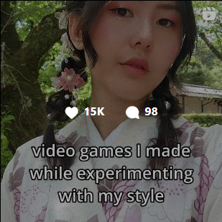
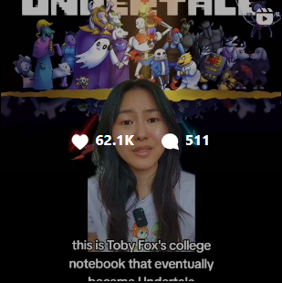
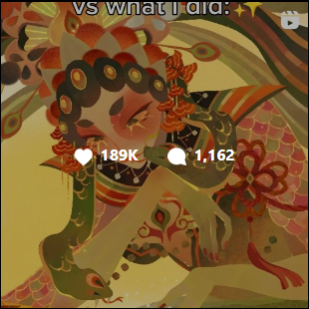
Strategic Influencer Sponsorships
Sondering Emily
80.8k Subscribers
Sponsor emily to use her artistic talents to create dedicated assets for a level design, a new monster, and her own character model that will be added into sluggerpunk along with getting her own creator code.

Slide 18
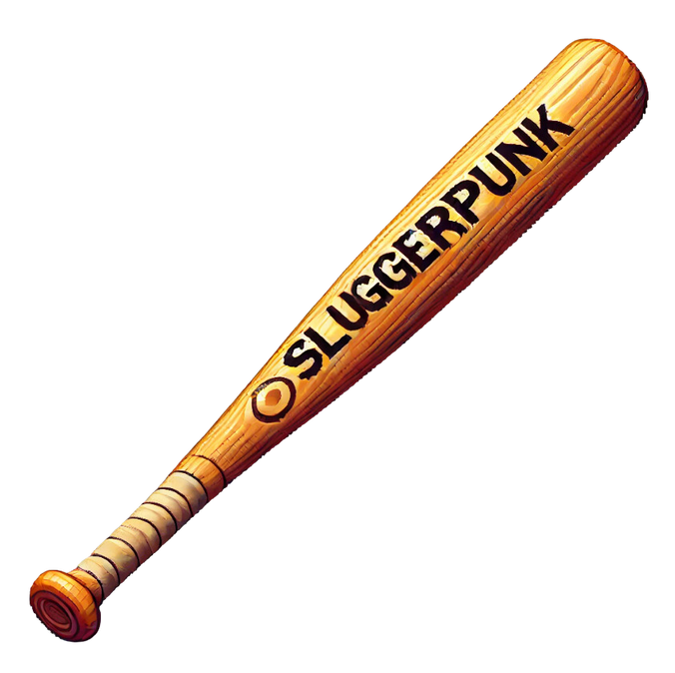
Strategic Influencer Sponsorships
GIVEAWAY
  Emily WILL GET TWO SLUGGERPUNK BRANDED BASEBALL BATS
  loop giveaway contest held on her personal social media
    follow her and the official “sluggerpunkgame” account
    repost onto their own stories
    one lucky contestant will be selected after 72 hours
Notes:
Emily has been selected to the first influencer that will have her own sluggerpunk giveaway with her fans in which a lucky winner can get a sluggerpunk engraved baseball bat.

Slide 19





Microtransactions
Slug currency
tier 1
tier 2
tier 3
tier 4
tier 5
100 slugs
$1.99
400 slugs
$5.99
800 slugs
$10.99
1200 slugs
$15.99
1600 slugs
$18,99
used for the purchase of in-game items, gear, special VFX, and new train lines (DLC)
Notes:
Players can purchase the in-game currency known as “Slugs” which is just another word for a fast baseball.

Slide 20


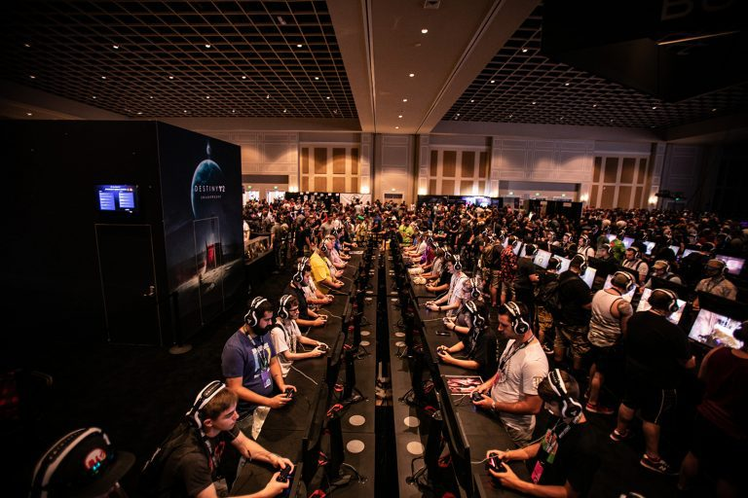
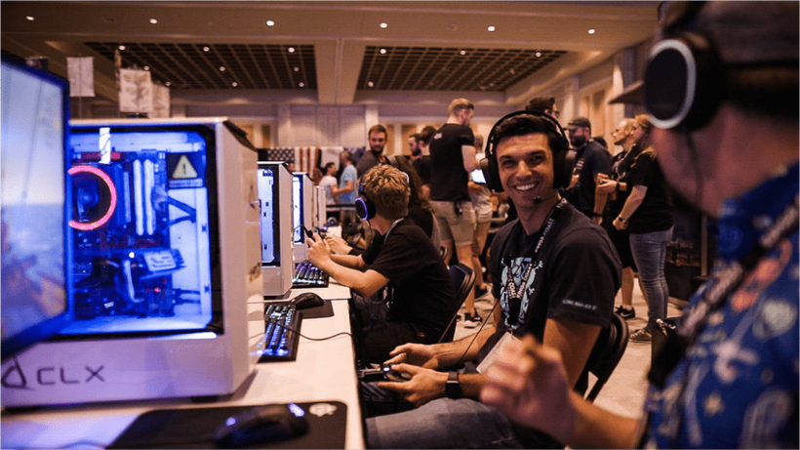
Event Strategy
x
Catching up with your favorite people in the industry in support of kids & families of St. Jude’s Children Research Hospital
Notes:
Present the idea of GCX. An event local to Orlando, Florida that raises funds in support of charity for St Jude’s hospital.
At this event, large creators across different games and niches show up in celebration of gaming culture.

Slide 21
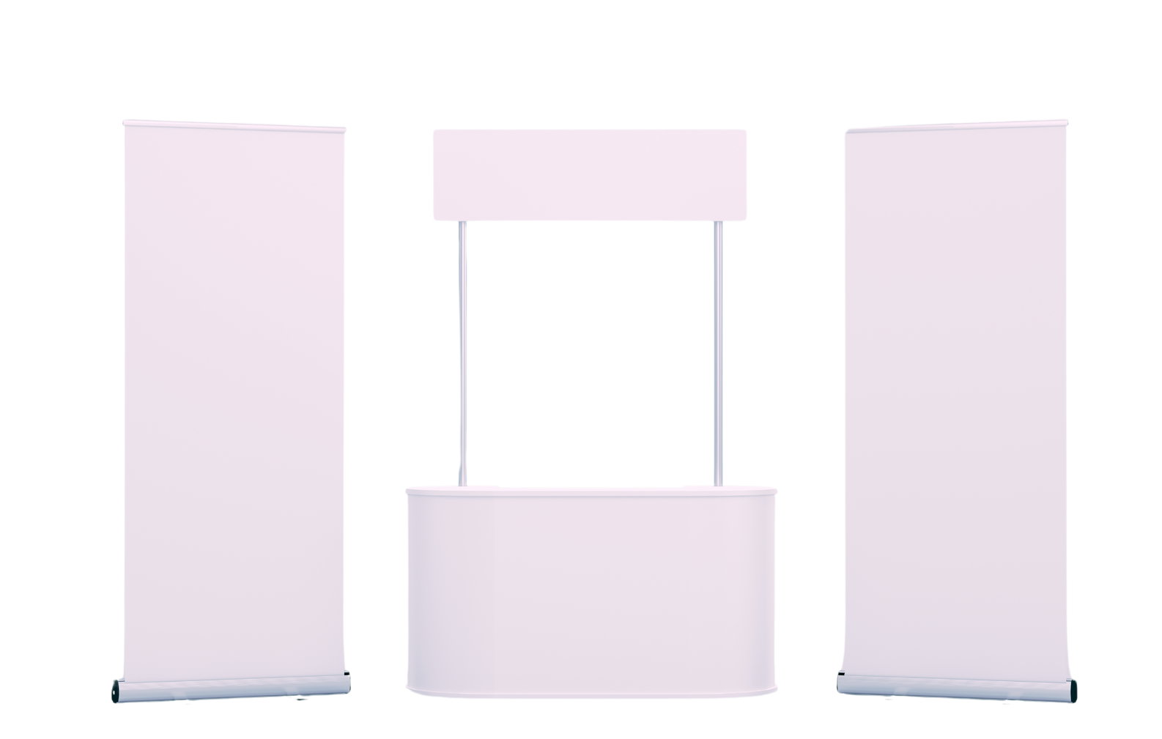
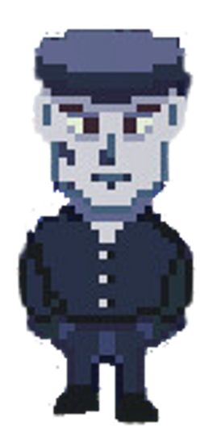
Event Strategy
The Sluggerpunk Booth
  three game demo stations on xbox
  Baseball throwing game
    free merch Participation prize
    winners get a sluggerpunk branded foam baseball bat
  high bpm electro music from the game’s soundtrack
  Booth workers in baseball outfits
Notes:
Banner mockups and desk mockup where people will be able to walk behind to access the demo stations on baseball stadium chairs and also play the baseball throwing game
To stay on brand, workers will wear baseball uniforms, and hand out sluggerpunk apparel.

Slide 22
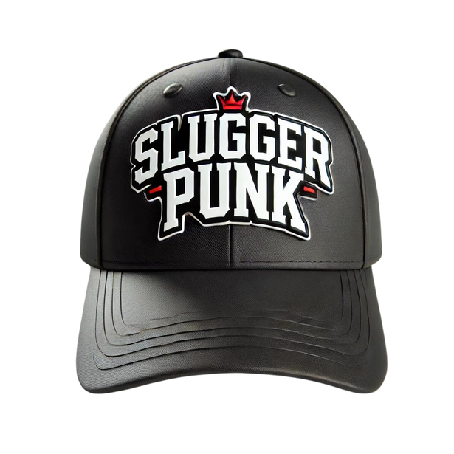
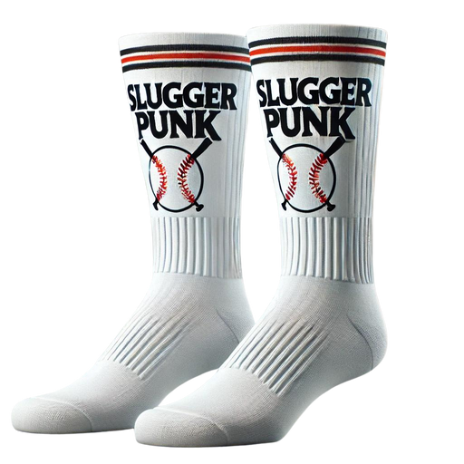
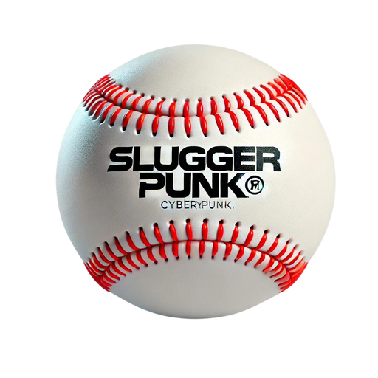
Event Strategy
Merch giveaway variety
  stressballs
  baseball socks
  baseball caps
  Temporary tattoos of sluggerpunk enemies
  Sluggerpunk currency codes
Notes:
Mockups of the type of merch we’d like to give away to people attending the booth.

Slide 23

Key Performance Indicators
  New downloads
  Average game session length
  Cost per acquisition
  Player retention rate
  Sales cycle
  Microtransactions
  Customer lifetime value

Slide 24

Influencer giveaway campaign with Sonderingemily for the sluggerpunk baseball bat
Influencer giveaway campaign with Sonderingemily for the 2nd sluggerpunk baseball bat
Release sluggerpunk globally on steam. Host a virtual launch event with 3rd giveaway & heavily promote
Influencer collaborations with Emily, Kim and Nook. share short form videos of early gameplay.
Timeline
sept. 25th
Oct. 15th
Nov. 15th
dec. 5th
Influencer teasers
First giveaway
Second giveaway
Game release
Teaser trailer
Ambassador prgm.
ad campaign
Launch countdown
Sept. 15th
Oct. 1st
oct. 20th
Dec. 1st
announce the game’s release date and launch the teaser trailer on Twitter, Instagram, Youtube and tiktok
ambassador program launch with early access codes and earn rewards
ambassador program launch with early access codes and earn rewards
5-day countdown with daily content on all platforms and code giveaways

Slide 25
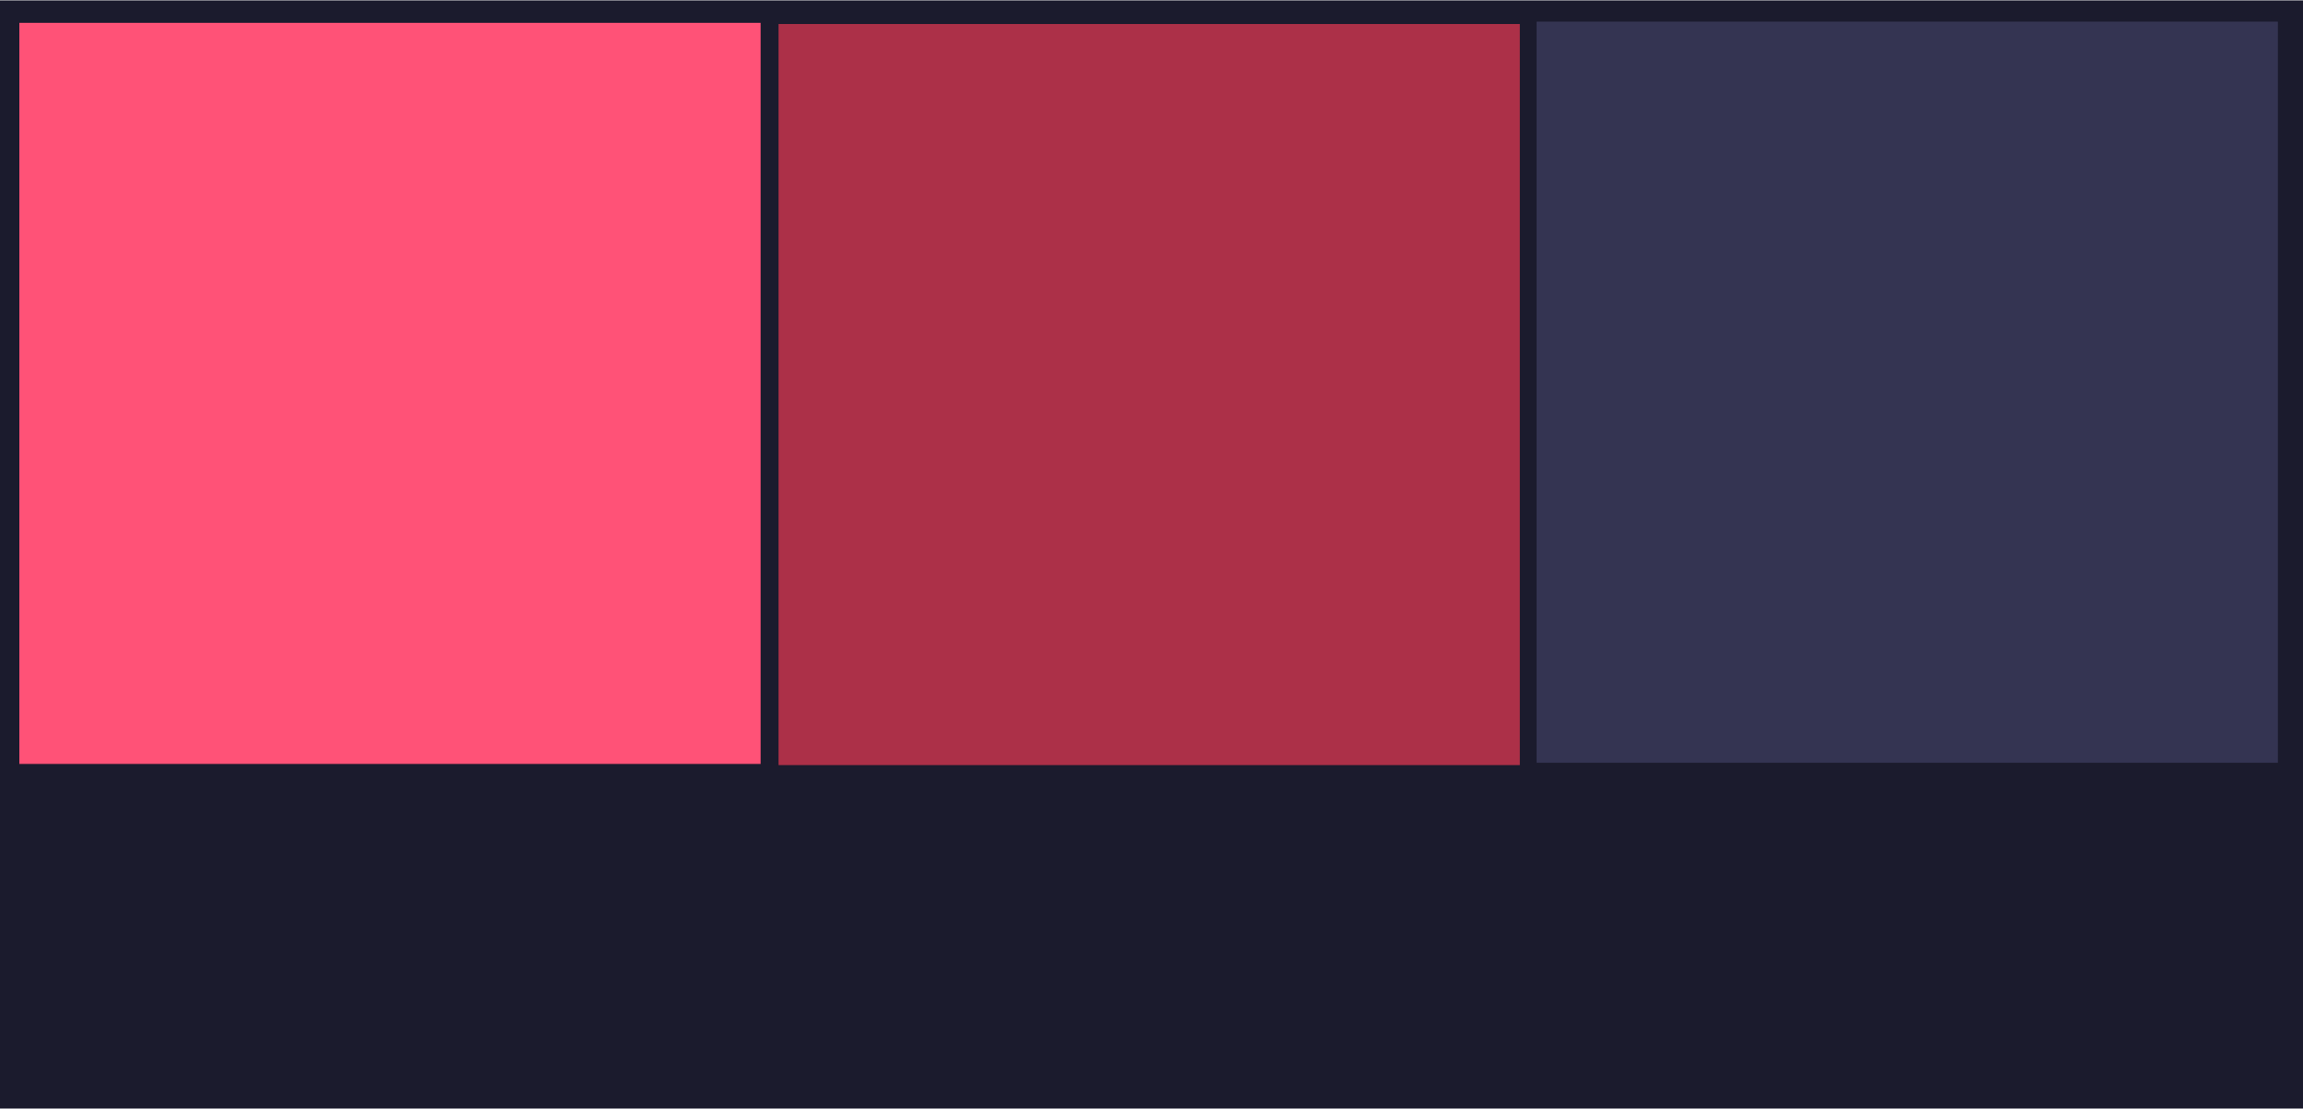
Branding
Official sluggerpunk icon
#ff5277
#ac3048
#343542
sluggerpunk banner
#cf453a

Slide 26


Contact John Fernando Hoyos Tobar
Email
j.fernan.hoyos@sluggerpunkgame.com
Discord
Pb_n_john
Portfolio
https://jfernanhoyos.wixsite.com/pbandjohn

Slide 27
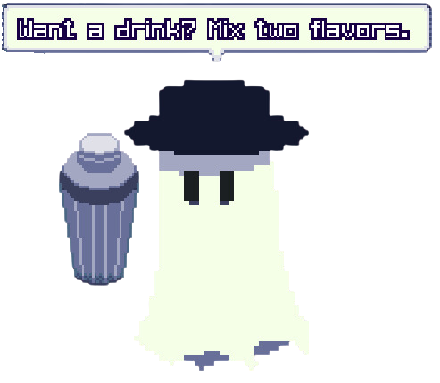
Thank YOU.

